Slide 1



GitHub Copilot

Slide 2

GitHub Copilot
Presented By:
Divyanshi Soni
Ananya Agrawal
Shiva Srivastava

Slide 3


What is Copilot?

Slide 4
Your AI Pair Programmer

Slide 5
Your AI Pair Programmer

Slide 6
Which model is GitHub copilot using ?
GitHub Copilot is powered by a generative AI model developed by GitHub, OpenAI, and Microsoft.
GitHub Copilot is trained on all languages that appear in public repositories. For each language, the quality of suggestions you receive may depend on the volume and diversity of training data for that language.

Slide 7
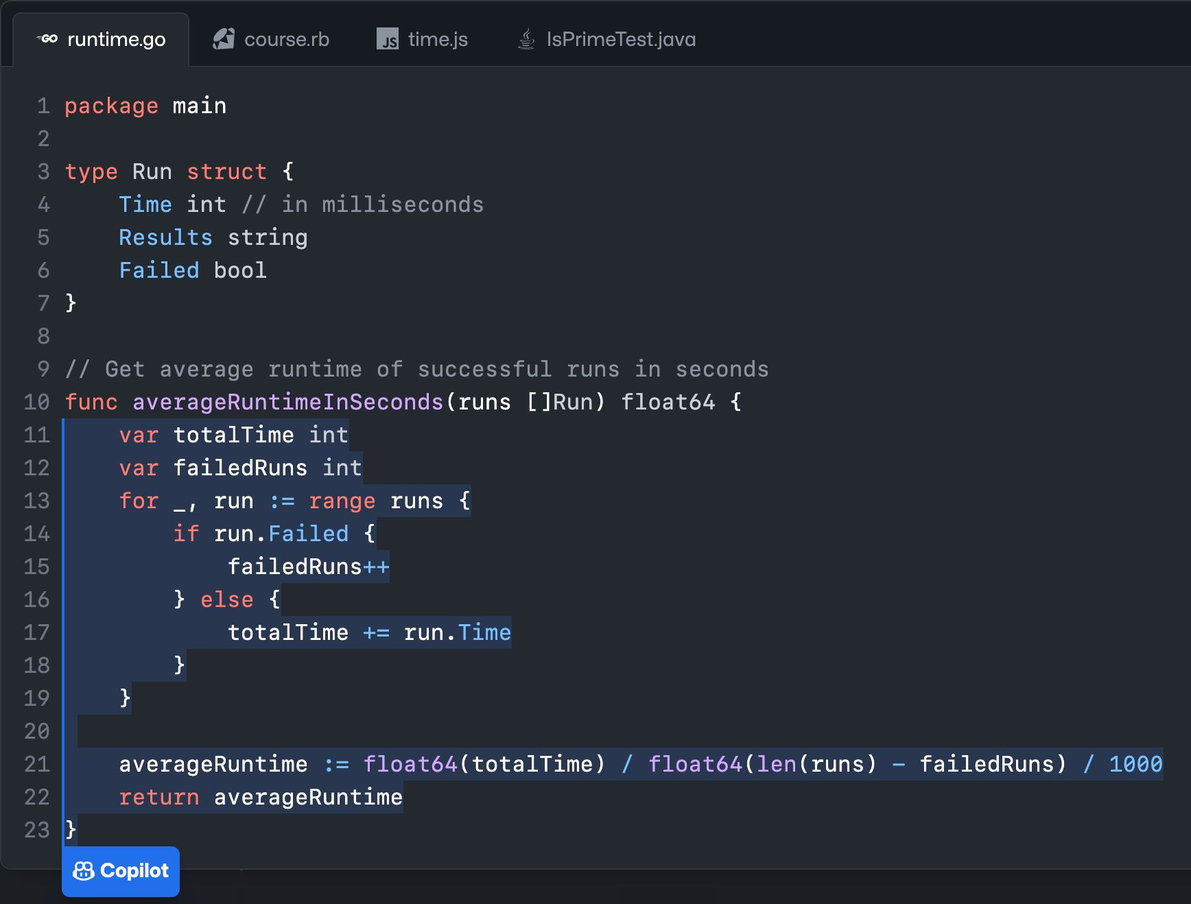










Notes:
Openai assosicative companies
Founder

Slide 8
Visual Studio
VS Code
JetBrains IDEs
Neovim
Notes:
Openai assosicative companies
Founder

Slide 9
Benefits and Features

Slide 10

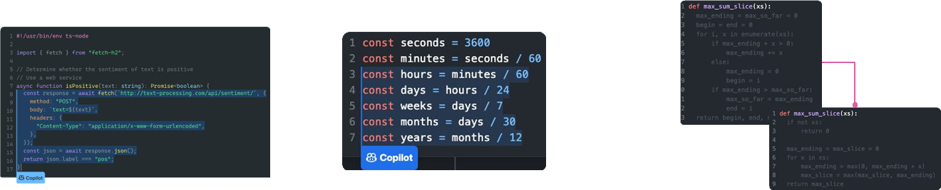
The main features
Convert comments to code
Autofill repetitive code
Show alternatives
Notes:
explain

Slide 11
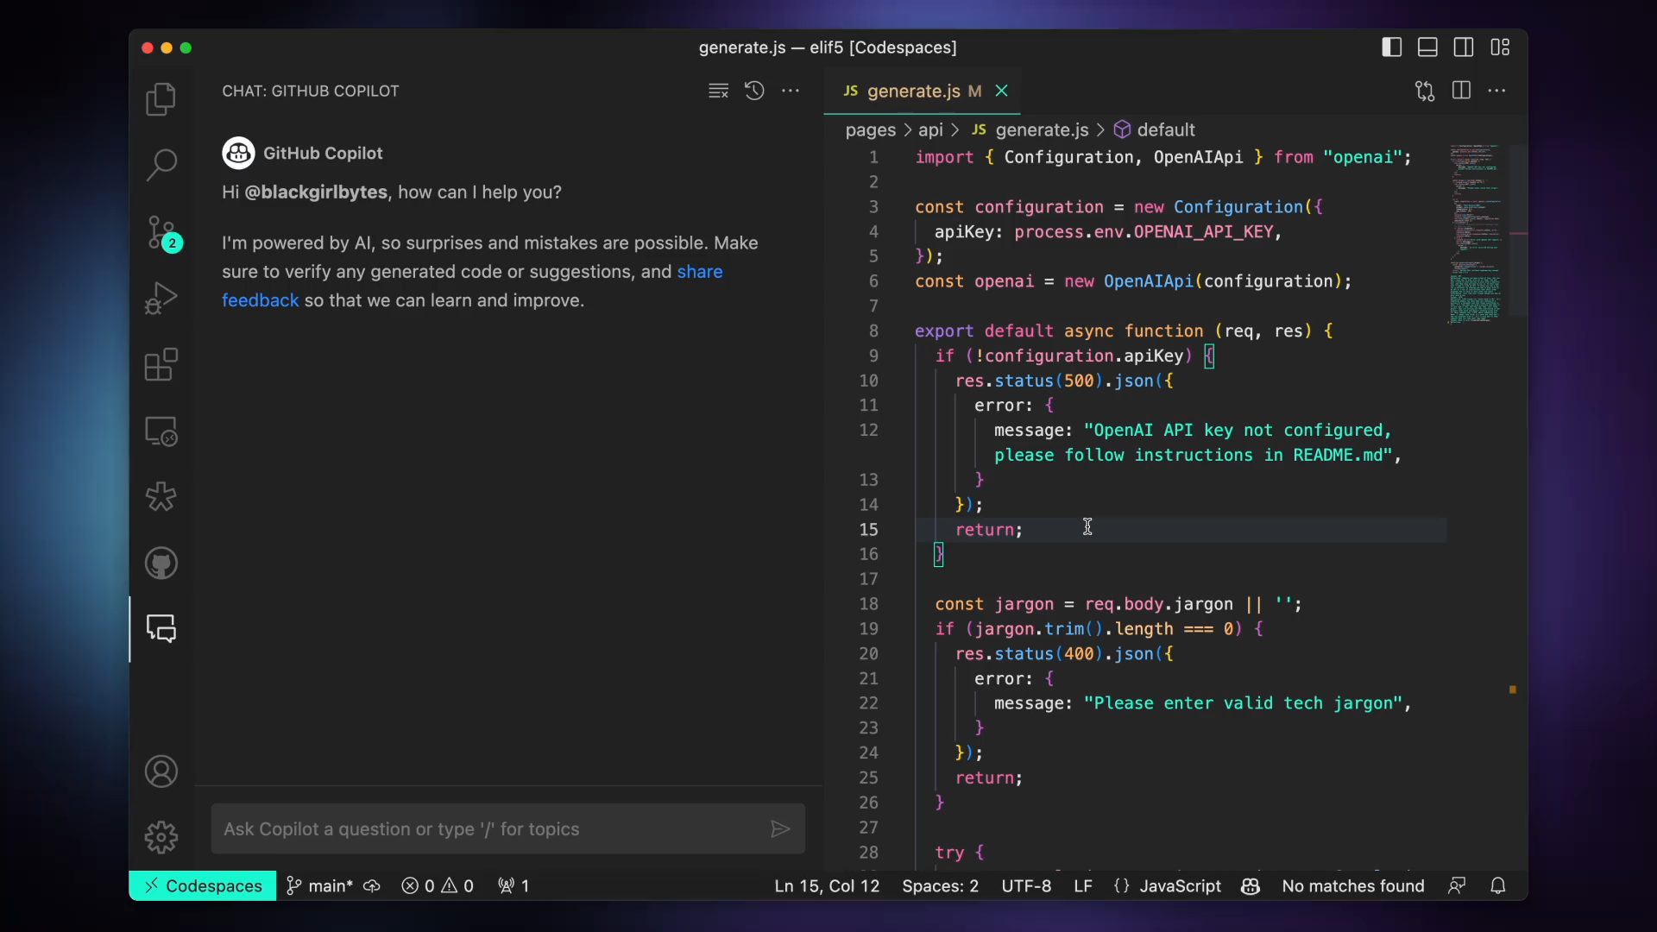
Auto code completion
Video or gif

Slide 12








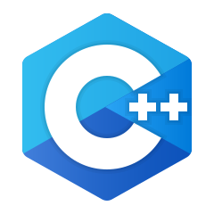
Language support
GitHub Copilot provides suggestions for numerous languages and a wide variety of frameworks, but works especially well for Java, Python, JavaScript, TypeScript, Ruby, Go, C# and C++
ruby
javascript
swift
Notes:
Add more language

Slide 13
Developers using GitHub Copilot…
https://github.blog/2022-09-07-research-quantifying-github-copilots-impact-on-developer-productivity-and-happiness/
88%
…have faster completion
87%
…exert less mental effort on repetitive tasks
77%
…spend less time searching
73%
…stay more in the flow
60%
…are more fulfilled with [their] job
59%
…are less frustrated when coding
https://github.blog/2022-09-07-research-quantifying-github-copilots-impact-on-developer-productivity-and-happiness/
Notes:
refrence

Slide 14

GitHub Copilot employs pattern recognition to analyze and understand the code being written, allowing it to offer relevant code suggestions and completions based on recognized coding patterns and structures. This helps developers write code more efficiently and in accordance with established practices.

Slide 15
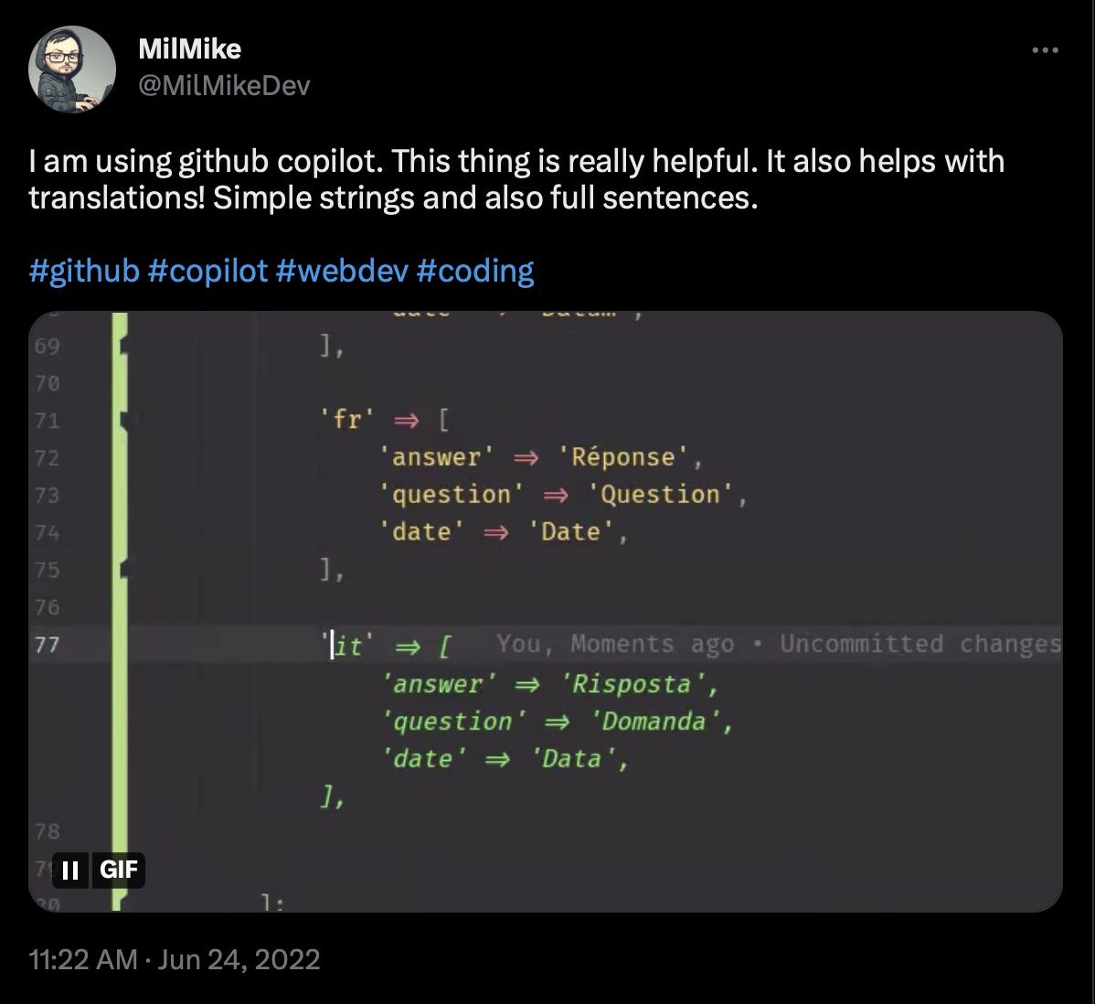
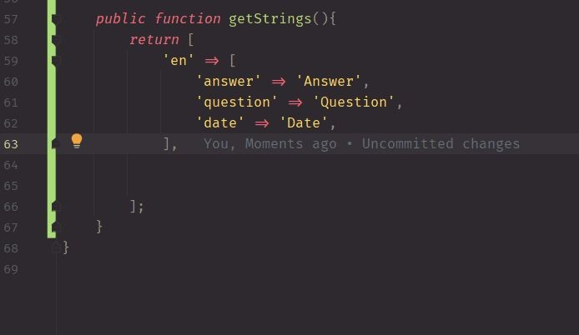
Pattern recognition

Slide 16
Limitation
Over-reliance: There's a risk that developers might become overly reliant on Copilot, potentially stunting their organic coding skills.
Sometimes, it's wrong: While Copilot is impressive, it's not infallible. It can sometimes suggest incorrect or inefficient code.
Licensing grey areas: There have been concerns about Copilot suggesting code that might be copyrighted or not appropriately licensed.
Notes:
Student totally rely on github (unfair means by student )
Increase dependency
Privacy in data security
License cost

Slide 17
Limitation
4.Potential for Lazy Coding: With auto-suggestions at hand, developers might opt for the first suggestion without considering if it's the best solution.
5.Loss of Coding Nuisance: Coding isn't just about getting the job done. The way someone codes, the style, and the nuances can get lost if you relies too much on automated suggestions.
6.Privacy Concerns: Some developers are worry about sharing their code with an AI, even if GitHub assures that the data is used responsibly.

Slide 18
Get Power of GitHub Copilot
Step1: Signup and Sigin
Step2: Installation

Slide 19
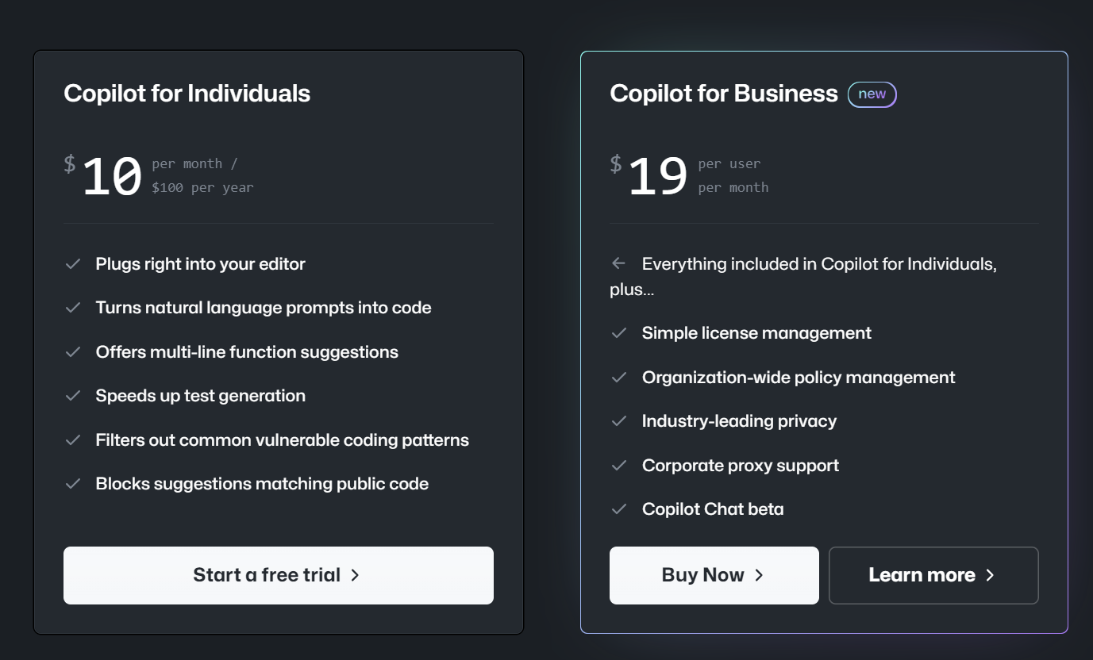
SignUp and SignIn
Using Paid Method

Slide 20
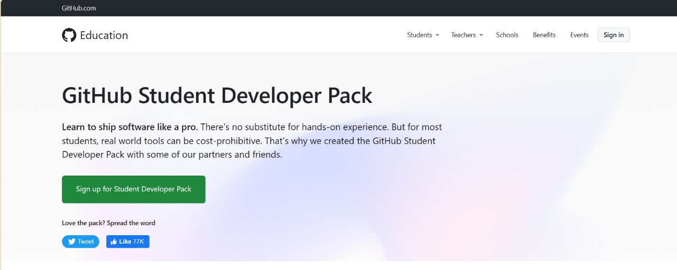
Method 2:
Using Benefit of Student ID

Slide 21
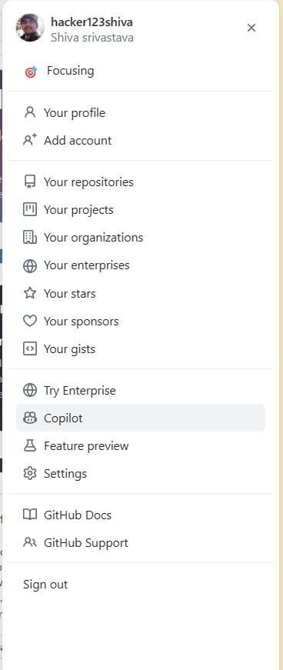

Slide 22
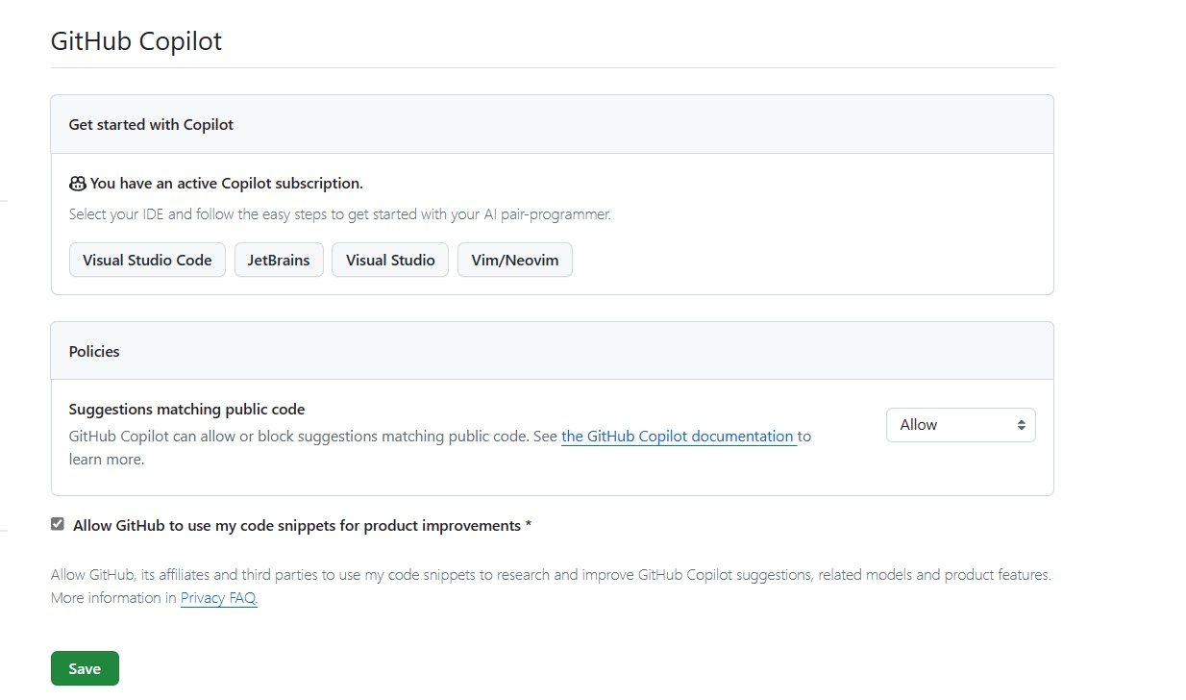

Slide 23
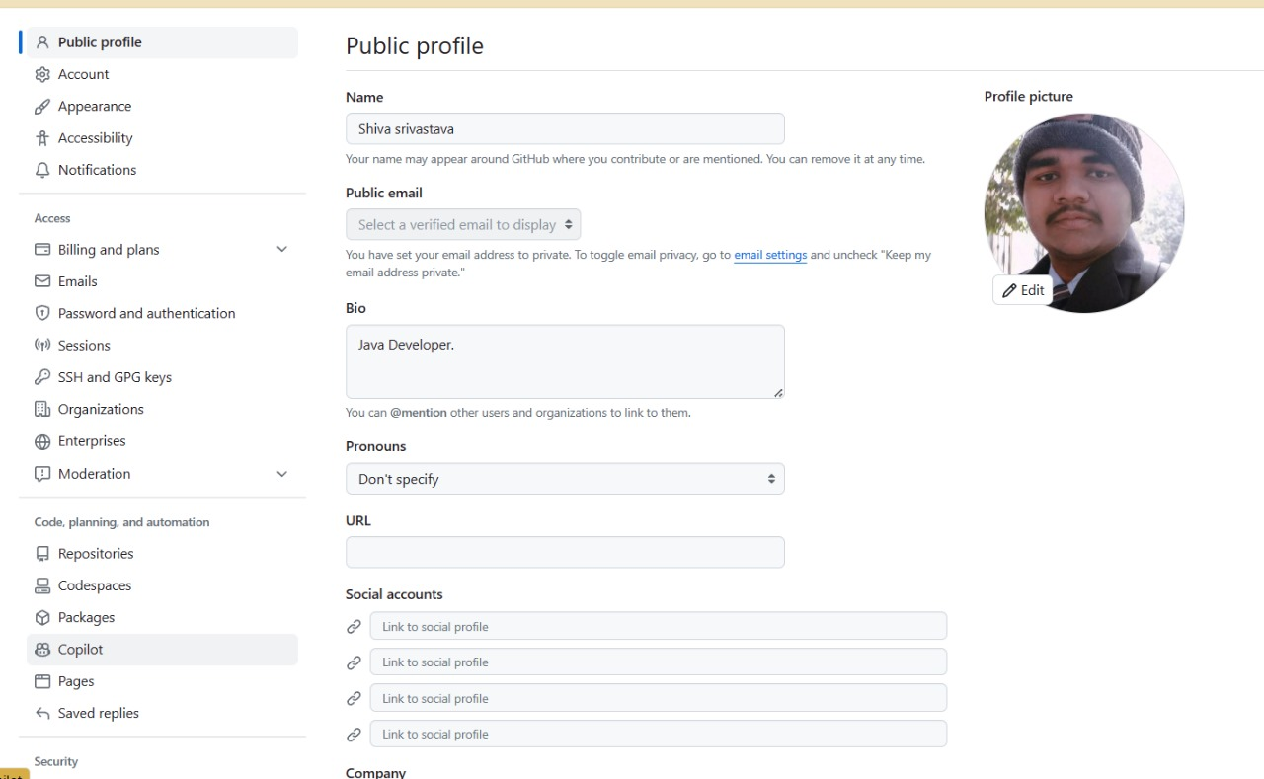

Slide 24
Installation

Slide 25
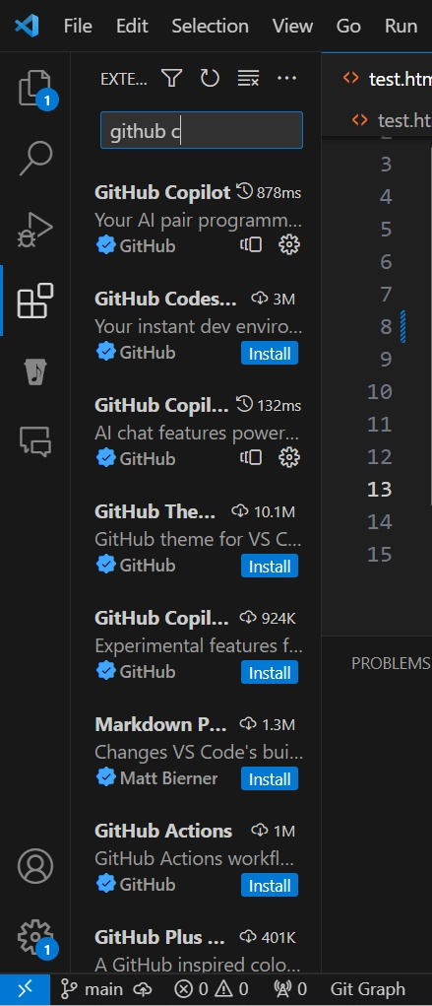
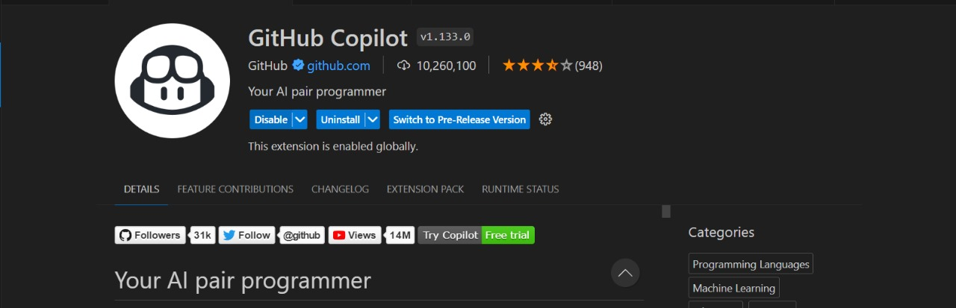

Slide 26



Competitors? Alternatives for GitHub Copilot
Few Competitor of Copilot:
Tabnine
Code Whisperer
Captain Stack
But We Only going to taking about Code Whisper…..

Slide 27
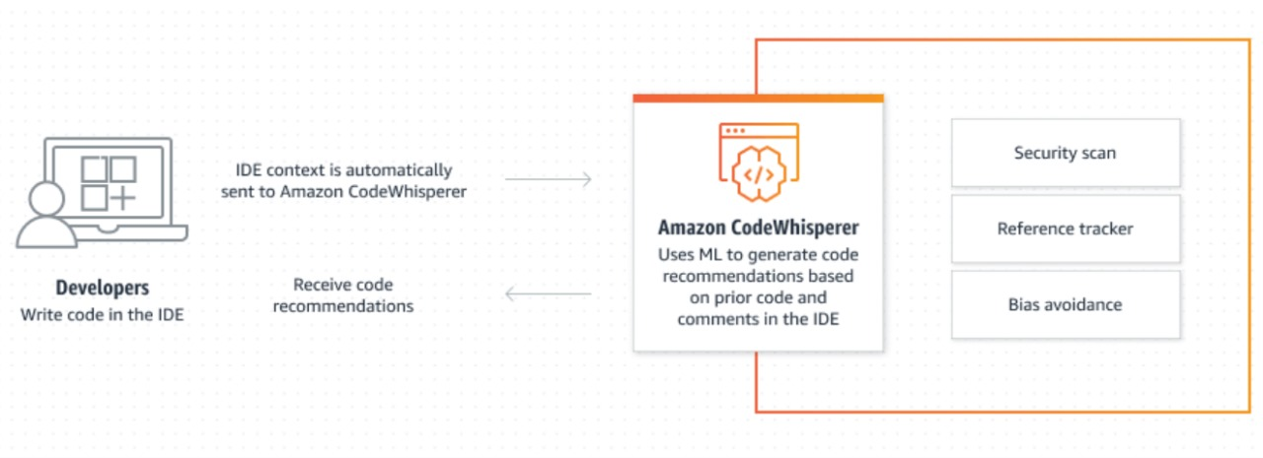
Code Whisperer:
Why code Whisper is one of the best competitor?
It is open source product of Amazon
Amazon Code Whisperer free for individual use, is now generally Available

Slide 28


Slide 29
AWS Code Whisperer VS GitHub Copilot
AWS Code Whisperer:
Built on Amazon Web Services Utilizes AI-powered NLP algorithms Emphasizes Context Understanding Higher Accuracy & Reliability
GitHub Copilot:
Built on OpenAI’s GPT-3 language techniques versatile across Languages and frameworks occasional inaccuracy in code generation
Key takeaways:
Choose based on Development needs & context AWS CodeWhishperer: AWS Cloud Optimization
GitHub: General code Assistance

Slide 30
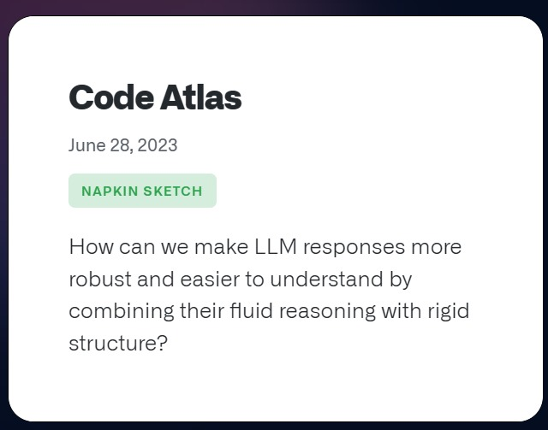
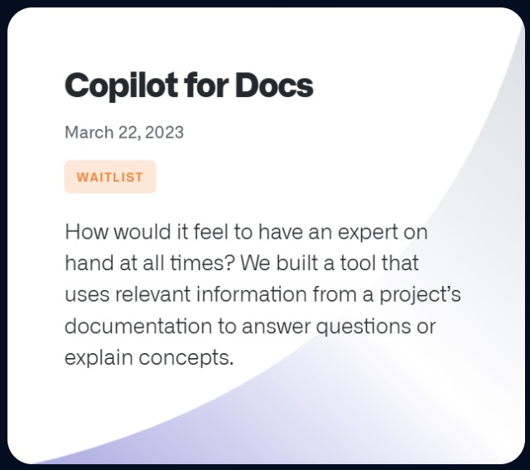
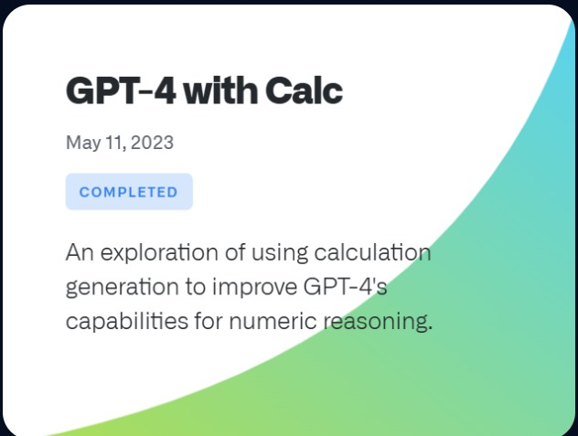
Other product and Future Scope
GitHub Next is a team of researchers and engineers at GitHub that investigates the future of software development

Slide 31
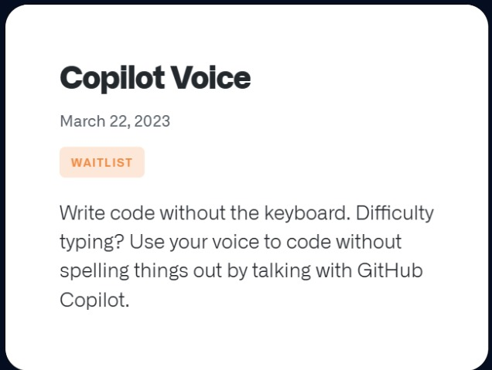
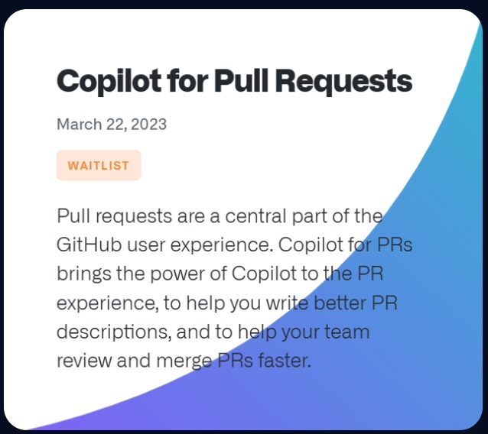



Slide 32

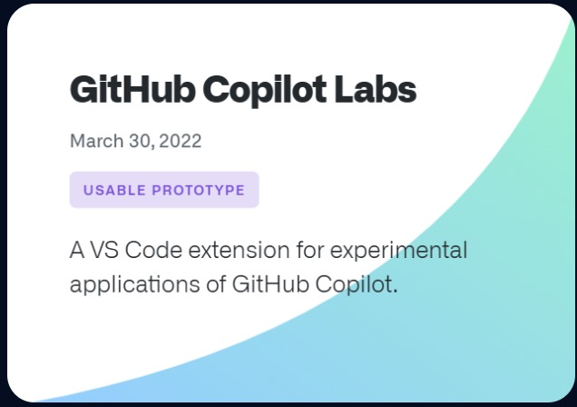
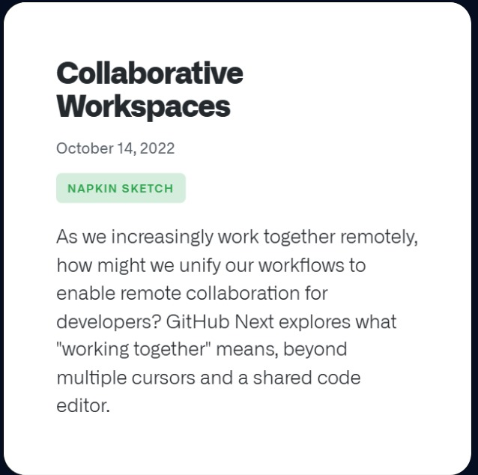

Slide 33
Improvements

Slide 34
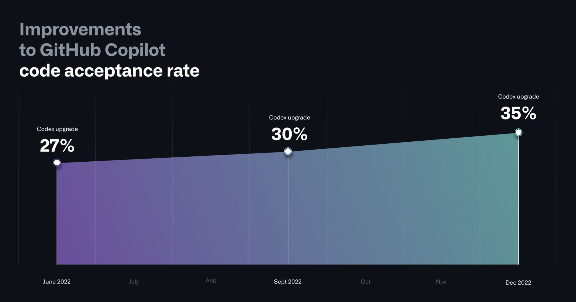
Notes:
https://github.blog/2023-06-27-the-economic-impact-of-the-ai-powered-developer-lifecycle-and-lessons-from-github-copilot/#:~:text=GitHub%20Copilot%20is%20turbocharging%20developer%20productivity.&text=On%20average%2C%20within%20the%20first,increased%20productivity%20from%20these%20acceptances.

Slide 35
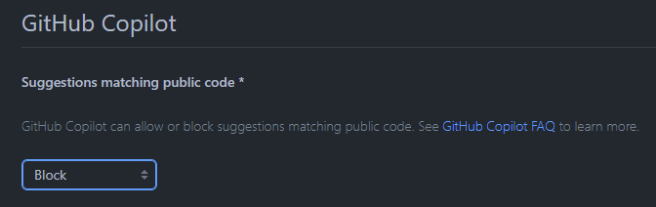
Block public code suggestions
Notes:
For eg : Yaha pe likh dena

Slide 36
Review

Slide 37
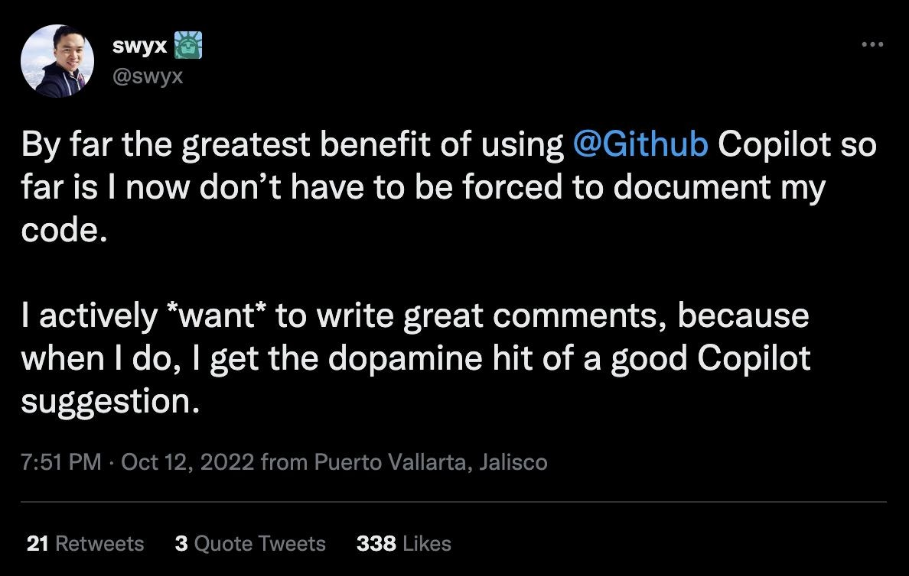
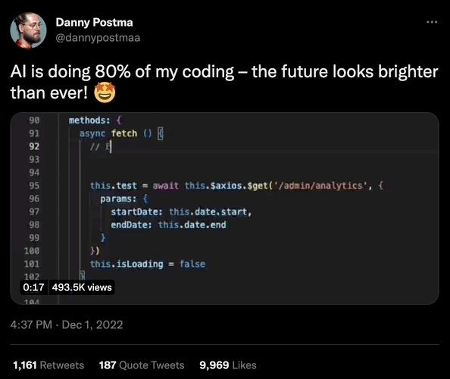
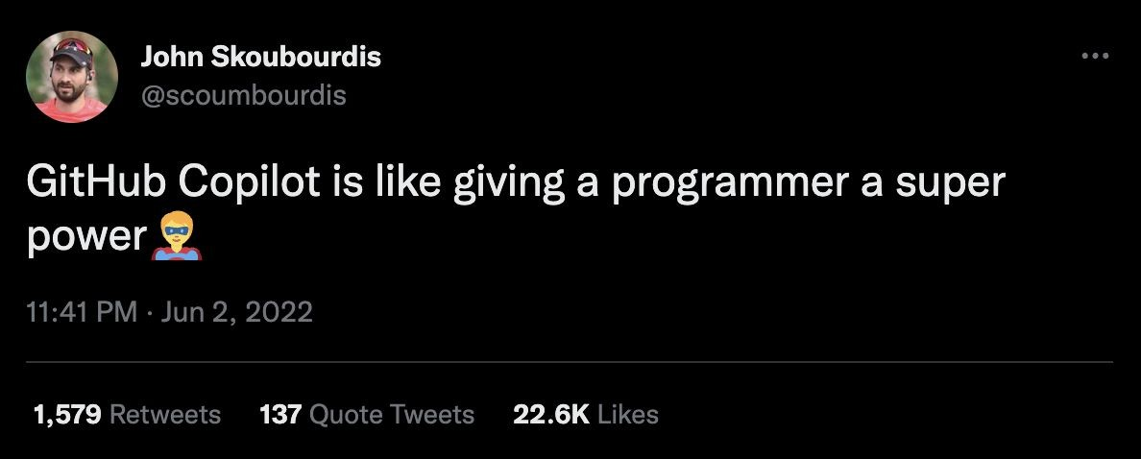
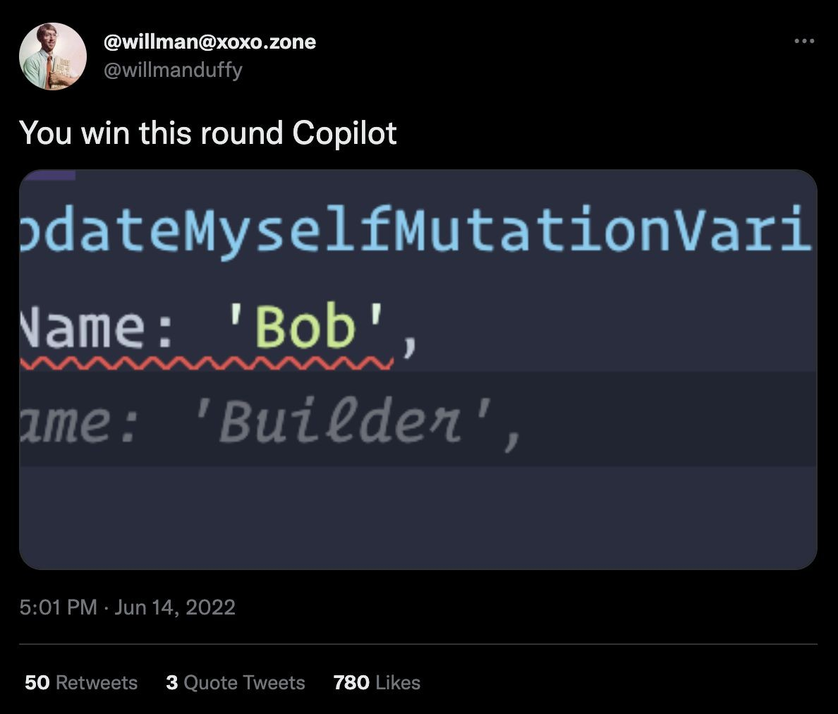
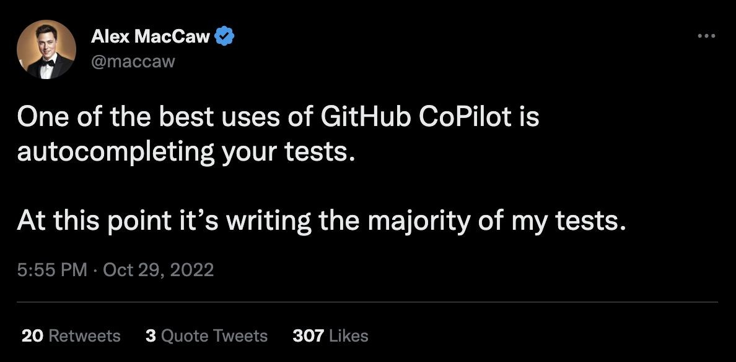
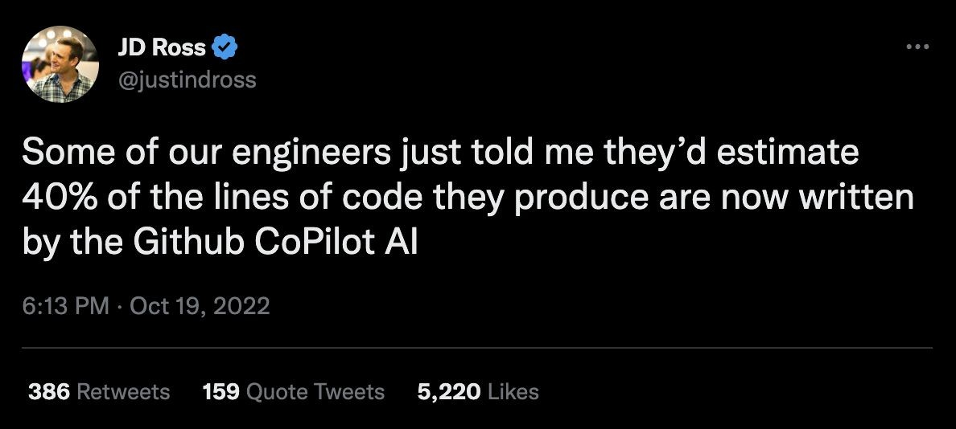
https://www.gartner.com/reviews/market/generative-ai-apps/vendor/github/product/github-copilot

Slide 38
Using GitHub Copilot Chat correlates with better code quality
85% of developers felt more confident in their code quality when authoring code with GitHub and GitHub Copilot Chat
85%
Code reviews were more actionable and completed 15% faster than without GitHub Copilot Chat
15%
88% of developers reported maintaining flow state with GitHub Copilot Chat
88%
https://github.blog/2023-10-10-research-quantifying-github-copilots-impact-on-code-quality/

Slide 39
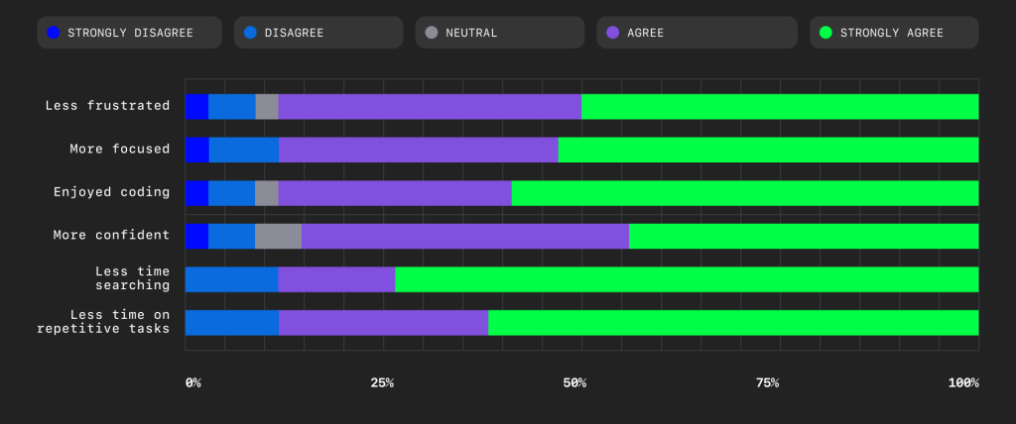
Participant rating : authoring an& reviewing code with GitHub Copilot Chart
https://github.blog/2023-10-10-research-quantifying-github-copilots-impact-on-code-quality/

Slide 40
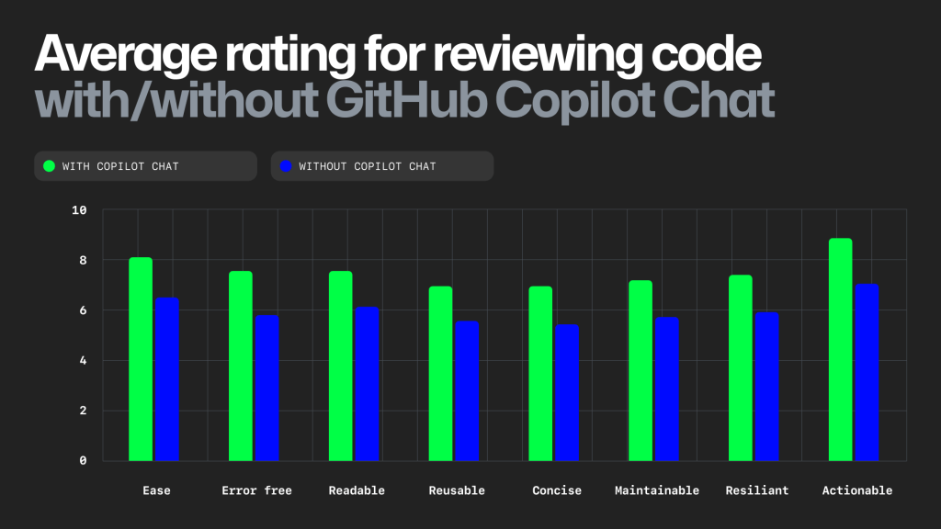
Average rating for reviewing code with or without GitHub Copilot Chat
https://github.blog/2023-10-10-research-quantifying-github-copilots-impact-on-code-quality/

Slide 41
https://github.blog/2023-10-10-research-quantifying-github-copilots-impact-on-code-quality/

Slide 42
Conclusion

Slide 43





GitHub Copilot can help you
Brainstorm
Jog your memory
Retain focus
Retain focus

Slide 45
Thank You

